Slide 1
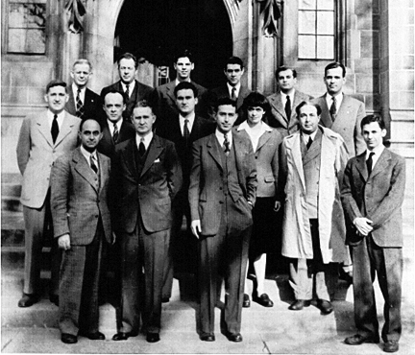
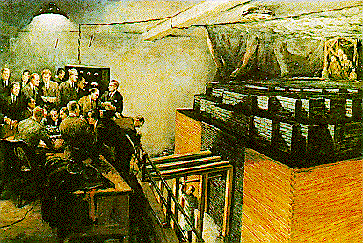
In the Beginning…
Original name for Argonne – the “Metallurgical Lab”, a code name for Enrico Fermi’s team as they constructed Chicago Pile-1, the first man-made nuclear reactor, under the University of Chicago’s abandoned football stands.
Dec. 2, 1942 – CP-1 achieved the first controlled fission chain reaction.
1943 – CP-1 was moved by the university to the Argonne forest preserve, creating the facility that would become Argonne National Laboratory.
1946 – The US government designated Argonne as the first national laboratory, with a mission to conduct “cooperative research in nucleonics”.

Slide 2
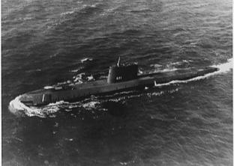
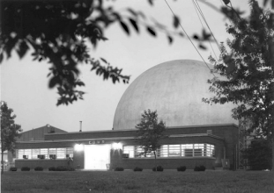
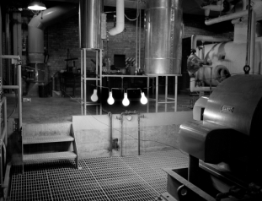
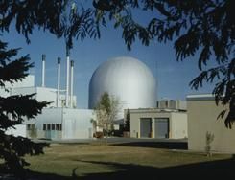
Argonne research: the foundation for the nuclear power industry
Original name for Argonne – the “Metallurgical Lab”, a code Argonne/Westinghouse partnership developed the first submarine reactor (Nautilus), which led to…
Commercial pressurized water reactor designs.
Argonne experiments proved the boiling water reactor concept.
Argonne’s EBR-I was the first nuclear reactor to generate electricity.
Argonne’s EBR-II demonstrated a complete fast reactor power plant with onsite fuel reprocessing.
Learn more in the Nuclear Energy Exhibit!

Slide 3
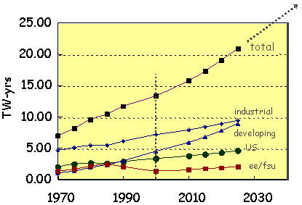
Argonne’s Vision for Nuclear Energy
World Energy Demand
Nuclear fission is a major energy source today and has vast potential to fuel and sustain development for many centuries.
Our goal is to advance the safe, sustainable use of nuclear energy
By incorporating science & technology innovations in the design and operation of nuclear energy systems
Extending our heritage dating back to Enrico Fermi and CP-1

Slide 4
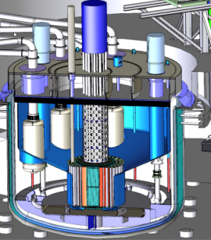
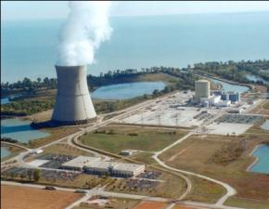
Argonne’s Nuclear Energy
Research and Development Goals
Continued development and demonstration of advanced fast reactors to enable sustainable use of nuclear energy
Advance the operation, safety, and regulation of current and near-term nuclear energy systems
Enhance national and international security

Slide 5
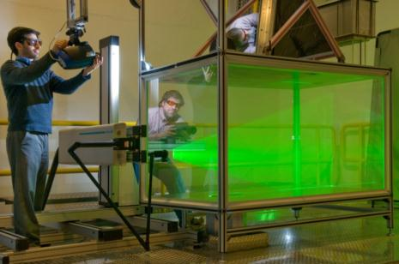
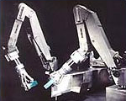
Nuclear Engineering Division Programs:
the means of achieving these goals
Advanced Modeling and Simulation: Using computers plus experiments to design advanced reactors.
Variation of Neutron Flux and Power in a Prismatic-Block VHTR
with Control Rod Insertion
System Technologies and Diagnostics: Cutting-edge equipment for operating and evaluating nuclear energy systems.
Argonne engineers studying coolant flow mixing in the MAX thermal mixing experiment at the Engineering Development Laboratories
Follow the footsteps to see demonstrations!

Slide 6
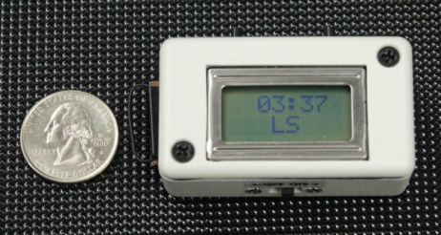
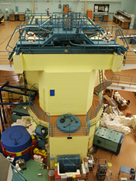
Nuclear Engineering Division Programs:
the means of achieving these goals
Refitting Research Reactors: Making highly-enriched uranium unavailable.
Visit the tent across the road to see how it’s done!
Time Trap is a new kind of tamper-indicating seal for cargo security and product authenticity applications.
Nuclear Nonproliferation and National Security: Improving nuclear safeguards, advancing security information systems.
The RPI research reactor in Portugal, converted to use low-enriched uranium (LEU) fuel

Slide 7
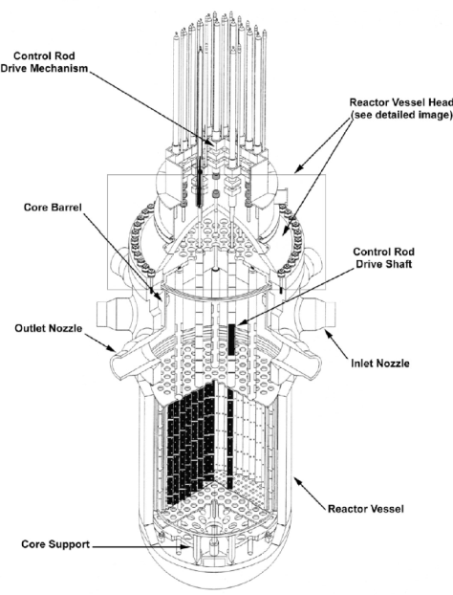
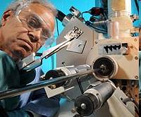
Nuclear Engineering Division Programs:
the means of achieving these goals
Nuclear Energy Science: Improving materials used in nuclear power plants.
Light Water Reactors: Making current commercial reactors even better as we develop better ways to test the parts that make up the reactors.
Studying the corrosion of metallic alloys

Slide 8
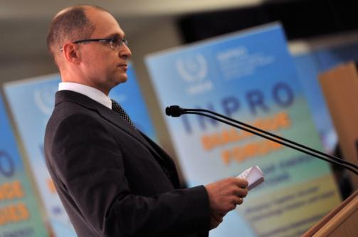
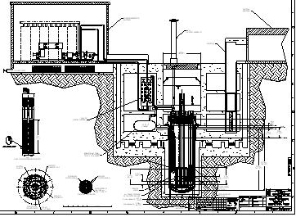
Nuclear Engineering Division Programs:
the means of achieving these goals
Engineering Development: Advanced reactors, recycle used fuel
Learn more in the Nuclear Energy Exhibit!
International Programs: Training in Nuclear Power Systems for people from around the world
Layout for an Argonne-designed Small Modular Fast Reactor

Slide 9
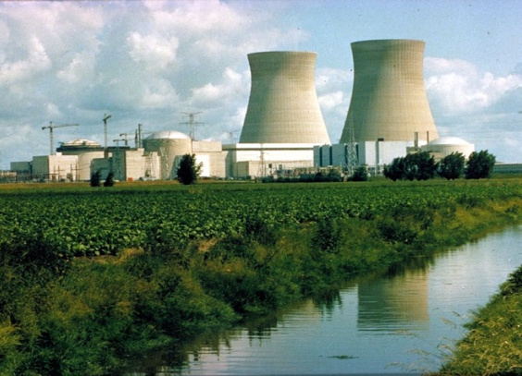
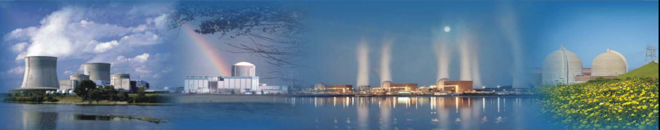
Argonne and the Nuclear Engineering Division
maintain a key role in advancing nuclear energy
as a proven, abundant and non-emitting
energy source.
Thanks for visiting us; enjoy the exhibits.
Be sure to ask lots of questions!

